Slide 1
Chapter 3
Introduction to Optimization Modeling
Winston/Albright
Practical Management Science, 6e
© 2019 Cengage. May not be scanned, copied or duplicated, or posted to a publicly accessible website, in whole or in part.

Slide 2
Solver’s sensitivity report (1 of 3)
Solver offers you the option to obtain a sensitivity report.
The report is based on a well-established theory of sensitivity analysis in optimization models.
Solver’s sensitivity report performs two types of sensitivity analysis:
On the coefficients of the objectives.
On the right sides of the constraints.

Slide 3
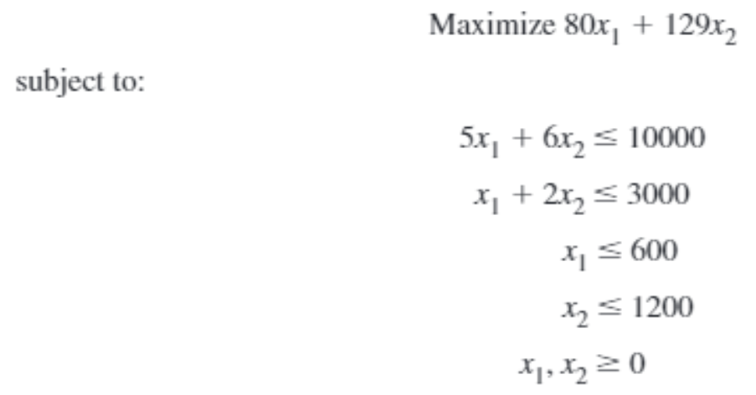
An algebraic model (4 of 5)

Slide 4
Solver’s sensitivity report (2 of 3)
On the Solver run, a sensitivity report is requested in Solver’s final dialog box.
The sensitivity report appears on a new worksheet, and contains two sections.
The top section is for sensitivity to changes in the coefficients. Each row in this section indicates how the optimal solution changes if one of these coefficients changes.
The bottom section is for sensitivity to changes in the right sides. Each row in this section indicates how the optimal solution changes if one of these availabilities changes.

Slide 5
Solver’s sensitivity report (3 of 3)
The reduced costs in the second column indicate, in general, how much the objective coefficient of a decision variable that is currently 0 or at its upper bound must change before the variable changes.
Each row in the bottom section corresponds to a constraint, although upper bound constraints on changing cells are omitted in this section.
A shadow price indicates the change in the optimal value of the objective when the right side of some constraint changes by one unit.

Slide 6
Next: Properties of Linear Models

